Slide 1

Diamond Price Prediction

Slide 2
CONTENTS
Title
Group Member Information
Role/Responsibilities and Contribution in project
Motivation
Objectives
Related work
Problem Statement
Proposed Solution
Results/Simulations
References

Slide 3
GROUP MEMBER INFORMATION
Sai Manjith Matta - 700730744
Soujanya Myla - 700731894
Anshul Reddy Anandula - 700734890
Sriharsha Kata - 700728960

Slide 4
ROLE/RESPONSIBILITIES AND CONTRIBUTION IN PROJECT
Project Task | Work done by
Data Analysis | Soujanya +Sai Manjith
Pre Processing | Anshul Reddy + Sriharsha
Model Building a) Knn b) Linear Regression c) Decision Tree | Anshul Reddy Sai Manjith Matta Anshul Reddy + Sriharsha
Documentation Report Video Making Ppt creation | Sai Manjith Soujanya Anshul Reddy + Sriharsha

Slide 5
MOTIVATION
Diamonds are one of the most valuable naturally occurring carbon compounds. These are in high demand due to their monetary rewards.
As many factors play in determining the price of the diamond, it is burdensome to tag a diamond with a particular price.
This problem gives an opportunity to leverage historic data and machine learning algorithms to predict the price of a diamond.
Having a system that could help in deciding the intrinsic value of a diamond gives an immense opportunity to both business and customers in transacting diamonds.
From a customer point of view, he/she can use the trained systems to assess before making a purchase.
At the same time, it also helps business to understand trends/demand in the market for a particular diamond.

Slide 6
OBJECTIVES
Our project aims to implement algorithms for predicting diamond prices. Algorithms we decided to implement are KNN, Decision Tree, Linear Regression algorithms.
Using trained algorithms, predict the price of the diamond given its features
Target on optimizing each model using various hyperparameter tuning mechanisms like Grid Search
Our contribution through this project is we were able to build above mentioned models using python as programming language
We were also able to hyper tune and produce a best model that has produced 97% score on the test dataset.

Slide 7
RELATED WORKS
There are several research articles proposed to predict diamond price prediction. Some of them are as follows
A research paper proposed by Harshvardhan et.al, uses regression algorithms like XGBOOST, KNN, Decision trees, Support Vector machines, Random Forest regressors and other 4-5 machine learning algorithms to train on the dataset. They were able to achieve 98% of accuracy through their approaches. They have also used the same dataset as our dataset. They found out that cat boost algorithm is proven to be the best optimal algorithm among all the others they have experimented with. They have used R2 score to evaluate their models.
Graima etal has provided an analysis of supervised models for diamond price prediction. They have evaluated eight different regression algorithms to train the predictor. Their best model Random Forest regression has resulted root mean square error of 580. The accuracy of random forest model has been stated as 97%.

Slide 8
Another research paper by Avinash Chandra Pandey others used ensemble learning is a technique in machine learning where they used two or more different algorithms to derive final output. This paper has used ensembled learning to predict gold as well as diamond prices.According to their study, they have performed dimensionality reduction techniques like Principal component Analysis (PCA) to reduce the features in the dataset. To ensemble different algorithms, they have chosen Random Forest Regressor, Adaboost, Light bgm and Xgboost. But this research also hasn't performed any hyper parameter tuning mechanism which had the potential to improve model performance significantly.
From our literature survey, we have concluded that most of the related works despite using wide range of algorithms haven’t focussed much on data pre-processing and parameter tuning mechanism. As per our knowledge based on literature survey, this is the first research work to perform hyper parameter tuning on selected algorithms to improve accuracy.

Slide 9
PROBLEM STATEMENT
The motive of this project is to predict the price of a diamond using machine learning algorithms. Price forecasting is the process of using historical data on a given product to predict the future price.
In recent times, price forecasting has been widely used in all domains to predict prices of various commodities.
As the price is a continuous variable, unlike classification algorithms which can be applied on discrete variables, regression algorithms must be applied to predict the price of a diamond.
In our problem, price of the diamond is dependant variable as it is heavily dependant on various other factors. In contrast, features like carat, colour, depth, dimensions and width are independent features as they don’t depend on each other.

Slide 10
PROPOSED SOLUTION
Data loading and analysis
Data pre-processing
Model training : KNN, Linear Regression, Decision Tree
Parameter Tuning
Predict on Test

Slide 11
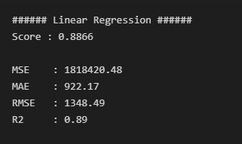
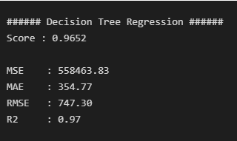
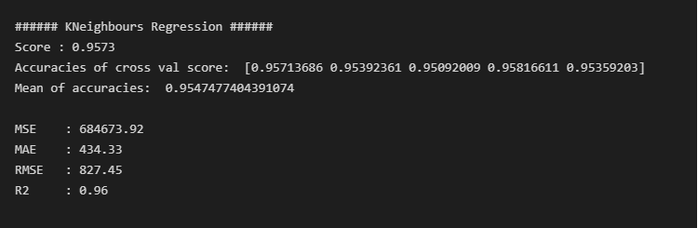
RESULTS AND SIMULATIONS
Following are the results of various experiments done.
Linear regression: Decision Tree Regression: K-Neighbours Regression:

Slide 12
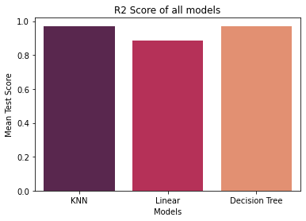
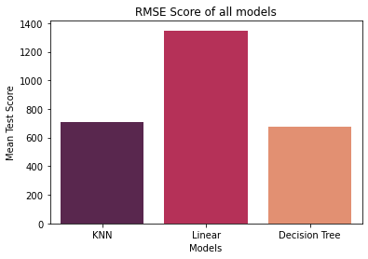
Comparison of all models:

Slide 13
REFERENCES
[1] GitHub repository containing code of the project
[2] https://www.kaggle.com/datasets/shivam2503/diamonds
[3] Wikipedia contributors. (2022, November 26). Diamond. Wikipedia. https://en.wikipedia.org/wiki/Diamond
[4] Editor. (2019, September 18). Price Forecasting Using Machine Learning Approaches in Electricity, Flights, Hotels, Real Estate, and Other Industries. AltexSoft. https://www.altexsoft.com/blog/business/price-forecasting-machine-learning-based-approaches-applied-to-electricity-flights-hotels-real-estate-and-stock-pricing/
[5] Alsuraihi, W., Al-hazmi, E., Bawazeer, K., & AlGhamdi, H. (2020, March). Machine learning algorithms for diamond price prediction. In Proceedings of the 2020 2nd IVSP (pp. 150-154).

Slide 14
[6] Pandey, A. C., Misra, S., & Saxena, M. (2019, August). Gold and diamond price prediction using enhanced ensemble learning, IEEE.
[7] Sharma, G., Tripathi, V., Mahajan, M., & Srivastava, A. K. (2021, January). Comparative analysis of supervised models for diamond price prediction.(pp. 1019-1022). IEEE.
[8] Marmolejos, José M. Peña. “Implementing Data Mining Methods to
Predict of the Diamond Prices.” in 2018
ICDATA’18
.[9] Mihir, H., Patel, M. I., Jani, S., & Gajjar, R. (2021, December). Diamond Price Prediction using Machine Learning. In 2021 2nd International Conference on Communication, Computing, and Industry 4.0 (C2I4) (pp. 1-5). IEEE.
[10] Cardoso, M. G., & Chambel, L. (2005). A valuation model for cut diamonds. ITOR - International Transactions in Operational Research, 12(4), 417-436.
[11] Kotsiantis, S. B. (2013). Decision trees: a recent overview. Artificial Intelligence Review, 39(4), 261-283.
[12] Weron, R. (2014). Electricity price forecasting: A state-of-the-art review with a look ahead. International journal of forecasting, 30(4), 1030-1081.
[13] Diamond-The most popular gemstone [online] https://geology.com/minerals/diamond.shtml

Slide 15
[14] Brandt, J. A., & Bessler, D. A. (1983). Price forecasting and evaluation: An application in agriculture. Journal of Forecasting, 2(3), 237-248.
[15] 3.2. Tuning the hyper-parameters of an estimator. (n.d.). Scikit-learn. https://scikit-learn.org/stable/modules/grid_search.html
[16] 1.10. Decision Trees. (n.d.). Scikit-learn. https://scikit-learn.org/stable/modules/tree.html
[17] Supervised vs Unsupervised Learning - Javatpoint. (n.d.). www.javatpoint.com. https://www.javatpoint.com/difference-between-supervised-and-unsupervised-learning
[18] sklearn.linear_model.LinearRegression. (n.d.). Scikit-learn. https://scikit-learn.org/stable/modules/generated/sklearn.linear_model.LinearRegression.html
[19]https://scikit-learn.org/stable/modules/generated/sklearn.preprocessing.LabelEncoder.html
[20] https://scikit-learn.org/stable/modules/generated/sklearn.preprocessing.StandardScaler.html

